Slide 1
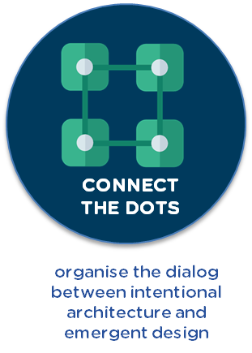













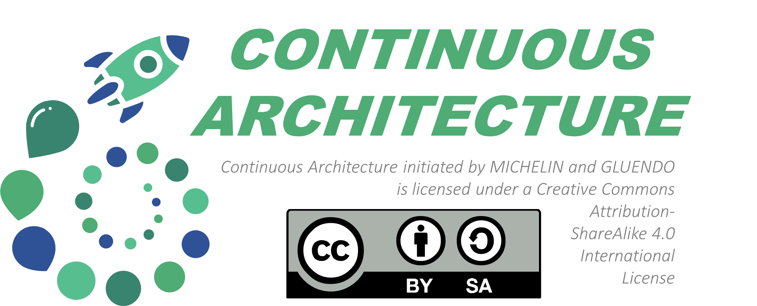
HARD RULES
Intentional Architecture
Architects community provides guidance for cross-team design and implementation synchronization, ensuring eventual integrity @scale.
HARD RULES
ARCHITECTS
COMMUNITY
COMMUNITIES
OF
Practices
Enterprise
ARCHITECT
ARCHITECTURE RESPONSABILTY
ARCHITECTURE RESPONSABILTY
DIALOG ZONE
Guidelines
Constraints
High level
WEEKLY MEETING
Full stack
ARCHITECT
Kit
DECISION
LOG
Performance
operability
CONTINOUS ARCHITECTURE
FUNCTIONAL ISSUES
PRODUCT
ARCHITECT
CLASSIC ARCHITECTURE
LEFT OPEN
Needs
forward
TECHNICAL
ISSUES
Feedbacks
OPS /
SUPPORT
TECH LEAD
SQUADS
LEFT OPEN
SQUAD - DEV RESPONSABILTY
SQUAD - DEV RESPONSABILTY
TEAM
LEADER
Emergent Design
Necessary evolutionary and incremental implementation to ensure squads are responsive to changings end-users/stakeholders needs.
DELIVERY
SQUAD(s)
DEV.
DEV.
The design evolves hand-in-hand with business functionality. It is constantly tested.
DESIGN BY :
Notes:
Intentional vs Emergent
Emergent design alone is insufficient when developing large systems (can cause excessive rework, ….)
Intentional architecture constrains the emergent design, but at a high enough level of abstraction to allow the teams to effectively adapt the intentional part to their specific context.
At the same time, emergent design influences and corrects intentional architecture and also feeds new ideas for future, centralized, intentional effort.
Connect the dots:
The architect’s role is becoming more demanding because concerns that were previously confined to specialized domains need to be connected.
It required new skills for architects: make a lot of different specialist work together, problem solver, facilitation/animation,… Cela me parrait pas tres « key messages » ;-) a revoir
EMERGENT INSUFFICIENT
INTENTIONAL AT HIGH LEVEL, TO ADAPT
NEW IDEAS FROM EMERGENT
MORE DEMANDING ROLE
NEW SKILLS

